Slide 1
MATH221 Mathematics for Computer Science
Unit 3
Number Systems and Mathematical Induction

Slide 2
OBJECTIVES
Know what is the natural numbers and integers and rational numbers.
Know what is the well-ordered property.
Understand the application of the definition of odd and even integers.
Know what are prime and composite numbers.
Understand and apply Mathematical Induction.
Understand and apply the Generalized Principle of Mathematical Induction.
Understand the Sigma Notation and Recursive Definitions.
Understand and apply the Principle of Strong Mathematical Induction.

Slide 3
Unit 3a
Number Systems

Slide 4
The Set of Natural Numbers
The set of Natural Numbers, denoted by ℕ, consist of all positive “whole” numbers.
ℕ = {1, 2, 3, 4, …}
Is 0 an element of ℕ (notation 0 ∈ ℕ)?
No.
A set is a collection of elements (objects). For example, {0, 1, -1} is a set.

Slide 5
Well-ordering property
A set S together with an order ≤ is called well-ordered if every nonempty subset of S has a least element. That is, if A is a nonempty subset of S , then there is an s₀ ∈ A such that s₀ ≤ s for all s ∈ A.
Axiom 3.1:
The set of natural numbers ℕ with the usual order ≤ is well-ordered.

Slide 6
The set of integers Z
The set of integers Z is the collection of all the “whole” positive and negative numbers, and 0. So
Z = {. . . , −3, −2, −1, 0, 1, 2, 3, . . . }.
The order ≤ on N extends to the natural order ≤ on Z.
Axiom 3.2:
Any nonempty subset of integers that are greater than a fixed integer with the usual order ≤ is well-ordered.
However, the set of integers Z are not well-ordered with ≤.

Slide 7
Evens, odds, primes and composites
An integer m ∈ Z is even if m = 2j for some j ∈ Z.
An integer n is odd if n = 2k + 1 for some k ∈ Z.
An integer n > 1 is prime if whenever n = r × s for positive integers r and s , we have r = 1 or s = 1. An integer n > 1 is composite if it is not prime.
Example: -2 is an even integer, 5 and -3 are odd integers, 5 is a prime integer and 4 is a composite integer.

Slide 8

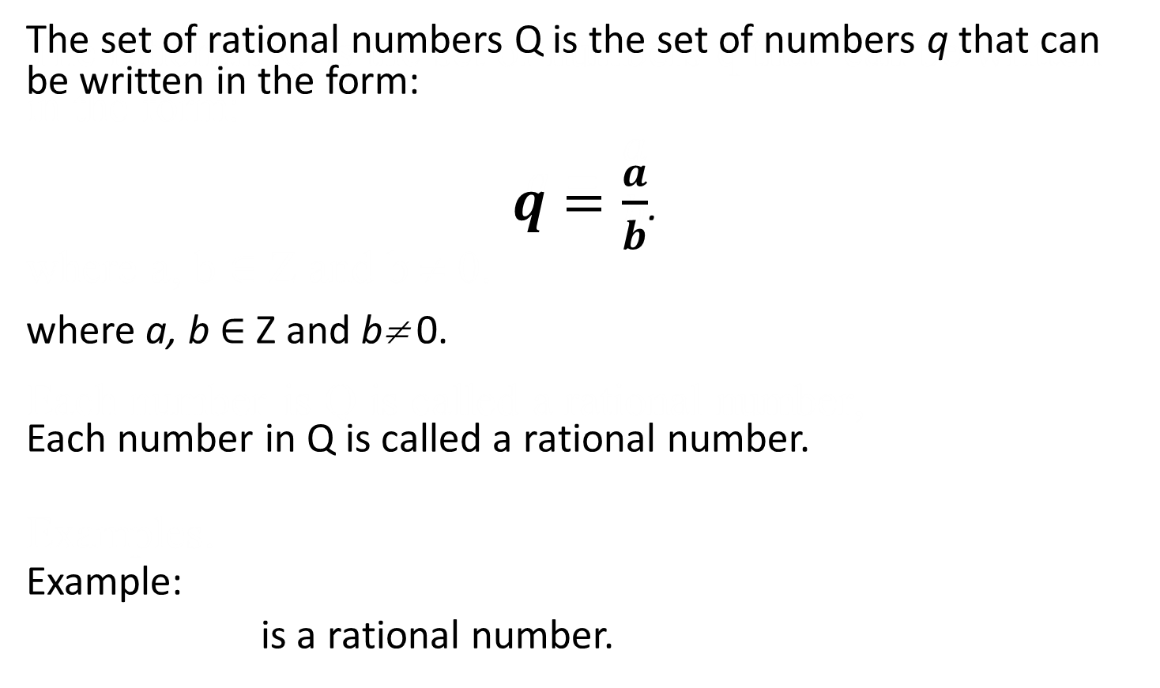

The set of rational numbers Q
The set of rational numbers Q is the set of numbers q that can be written in the form:
$q=\frac{a}{b}$.
where a, b ∈ Z and b≠ 0.
Each number in Q is called a rational number.
Example:
is a rational number.
$$0.4= 2/5$$

Slide 9
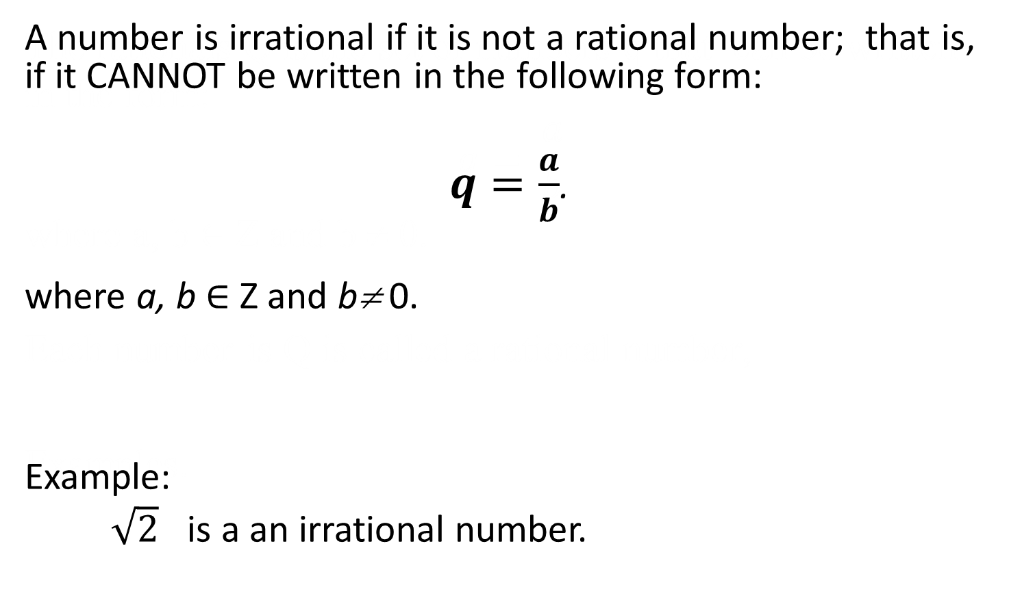
Irrational Numbers
A number is irrational if it is not a rational number; that is, if it CANNOT be written in the following form:
$q=\frac{a}{b}$.
where a, b ∈ Z and b≠ 0.
Example:
$\sqrt{2}$ is a an irrational number.

Slide 10
The set of real numbers ℝ
Both rational and irrational numbers are called real numbers.
That is, the set ℝ is formed by the combination of ℚ and the set of irrational numbers.
Hence, ℝ is different from both ℚ and Z.

Slide 11
Unit 3b
Mathematical Induction

Slide 12
The Basic Principle of Mathematical Induction: Example
Prove n³ > 2n - 2 for all natural numbers, n.
Can we use the exhaustive method to prove this statement ? No.
Let CLAIM(n) be “n³ > 2n – 2”.
For n = 1: CLAIM(1) is 1³ > 2 × 1 – 2
LHS = 1; RHS = 0 ⇒ LHS > RHS.
For n = 2: CLAIM(2) is 2³ > 2 × 2 – 2
LHS = 8; RHS = 2 ⇒ LHS > RHS.
For n = 3: CLAIM(3) is …
The process above will NEVER prove the CLAIM for ALL natural number n.

Slide 13
The Principle of Mathematical Induction
For all natural numbers n, let CLAIM(n) be a statement. If
1. CLAIM(1) is true, and
2. the truth of CLAIM(k) implies the truth of
CLAIM(k + 1) for all natural numbers k,
then CLAIM(n) is true for all natural numbers n.

Slide 14




The Principle of Mathematical Induction: Example
Prove 1 + 2 + … + n , for n ∈ ℕ.
Let CLAIM(n) be “1 + 2 + … + n ”.
Does the claim satisfy the conditions of the Principle of Mathematical Induction?
1. Is CLAIM(1) true?
CLAIM(1) is . LHS = 1; RHS = .
Therefore, LHS = RHS and so CLAIM(1) is true.
$$=\frac{n\left(n+1\right)}{2}$$
$$=\frac{n\left(n+1\right)}{2}$$
$$1=\frac{1\left(1+1\right)}{2}$$
$$\frac{2}{2}=1$$

Slide 15


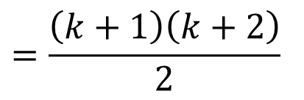
The Principle of Mathematical Induction: Example
2. We must show that for k ≥ 1,
CLAIM(k) is true ⇒ CLAIM(k + 1) is true.
Assume CLAIM(k) is true, that is,
1 + 2 + … + k (*)
Prove CLAIM(k + 1) is true, that is,
1 + 2 + … + k + (k + 1)
$$=\frac{k\left(k+1\right)}{2}$$
$$=\frac{\left(k+1\right)\left(k+1+1\right)}{2}$$
$$=\frac{\left(k+1\right)\left(k+2\right)}{2}$$

Slide 16
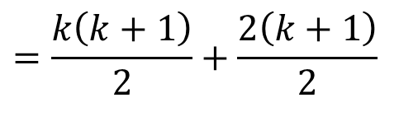
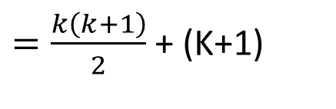
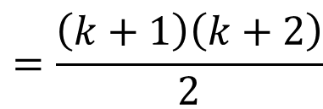
The Principle of Mathematical Induction: Example
LHS = 1 + 2 + … + k + (k + 1)
Therefore, LHS = RHS.
Therefore, CLAIM(k + 1) is true.
So, CLAIM(n) satisfies both the conditions of the Principle of Mathematical Induction.
Therefore, by induction, CLAIM(n) is true for all n ∈ ℕ.
$=\frac{k\left(k+1\right)}{2}$ + (K+1)
(Using *)
$$=\frac{k\left(k+1\right)}{2}+\frac{2\left(k+1\right)}{2}$$
$$=\frac{\left(k+1\right)\left(k+2\right)}{2}$$
(Factor out a (k + 1))

Slide 17
The Principle of Mathematical Induction: Summary
To establish an infinite family of claims, (CLAIM(1), CLAIM(2), CLAIM(3), …) using the Principle of Mathematical Induction, it is sufficient to carry out the following two steps:
Step 1: Prove that the first claim, CLAIM(1) is true.
Step 2: Give a general proof that if CLAIM(k) is true then CLAIM(k + 1) is also true, whatever the value of k ∈ ℕ.
The first step is called the basis step and the second step is called the inductive step.

Slide 18
The Principle of Mathematical Induction: Example
Prove n³ > 2n - 2 for all natural numbers, n.
Let CLAIM(n) be “n³ > 2n – 2”.
Step 1: CLAIM(1) is 1³ > 2 × 1 – 2.
LHS = 1; RHS = 0.
Therefore, LHS > RHS and so CLAIM(1) is true.
Step 2: Assume CLAIM(k) is true for some k ∈ ℕ, that is,
k³ > 2k – 2. (*)
Prove CLAIM(k + 1) is true, that is, prove that
(k + 1)³ > 2(k + 1) – 2.
that is, to prove that (k + 1)³ > 2k.

Slide 19
The Principle of Mathematical Induction: Example
LHS = (k + 1)³
= k³ + 3k² + 3k + 1 (refer to the formula in the Appendix)
> (2k – 2) + 3k² + 3k + 1 (using *)
≥ 2k – 2 + 3 + 3 + 1 (since 3k² ≥ 3, 3k ≥ 3, k ≥ 1 as k ≥ 1)
= 2k + 5
> 2k (since 5 > 0)
= RHS
Therefore, (k + 1)³ > 2k and so CLAIM(k + 1) is true.
Therefore, by induction, CLAIM(n) is true for all n ∈ ℕ.

Slide 20
The Need for Generalized Principle of Induction: Example
Prove that 2^{n} > 2n + 1 by induction.
Let CLAIM(n) be 2^{n} > 2n + 1 for n ∈ ℕ.
Step 1: CLAIM(1) is 2¹ > 2(1) + 1.
LHS = 2; RHS = 3.
LHS < RHS!!!
The fact is that 2^{n} > 2n + 1 is true for n ≥ 3, n ∈ ℕ.
Sometimes we would like to prove a CLAIM that only works for values greater than 4, say.
The Principle of Mathematical Induction can be generalized to “accommodate” this type of problem.

Slide 21
The Generalized Principle of Induction
Suppose that q is some integer. A statement is true for n ≥ q, where q ≠ 1. Then, we must use the Generalized Principal of Mathematical Induction as follows.
For all integers n ≥ q, let CLAIM(n) be a statement. If
1. CLAIM(q) is true, and
2. the truth of CLAIM(k) implies the truth of
CLAIM(k + 1) for all integers k ≥ q,
then CLAIM(n) is true for all integers n ≥ q.
Note that the proof is almost identical to the proof to that for the Principle of Mathematical Induction.

Slide 22
The Generalized Principle of Induction: Note
This generalized principle is applied in the same way as before, except that at
Step 1: we prove CLAIM(q) instead of CLAIM(1), and
Step 2: we may need the information that k ≥ q instead of k ≥ 1.
Note that q can be any integer: positive, negative or zero.

Slide 23
Exercise:
Prove that 2^{n} > 2n + 1 for n ≥ 3, n ∈ ℕ.
Let CLAIM(n) be 2^{n} > 2n + 1.
Step 1: CLAIM(3) is 2³ > 2(3) + 1.
LHS = 8; RHS = 7.
Therefore, LHS > RHS and so CLAIM(3) is true.
Step 2: Assume CLAIM(k) is true for some k ≥ 3, k ∈ ℕ, that is,
2^{k} > 2k + 1. (*)
Prove CLAIM(k + 1) is true, that is, prove that
2^{k + 1} > 2(k + 1) + 1 = 2k + 3.

Slide 24
Exercise:
LHS = 2^{k + 1}
= 2^{k}(2)
> (2k + 1)(2) (using *)
= 4k + 2
= 2k + 2k + 2
> 2k + 1 + 2 (since 2k > 1 as k ≥ 3)
= 2k + 3
= RHS
Therefore, 2^{k + 1} > 2k + 3 and so CLAIM(k + 1) is true.
Therefore, by induction, CLAIM(n) is true for all natural numbers n ≥ 3.
Note: Multiplication of two Indices
p^{m+n} = p^{n}⋅ p^{m}

Slide 25
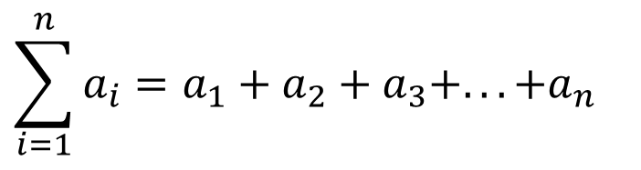
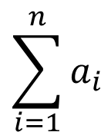
Sigma Notation
$$\sum_{i=1}^{n}{a_{i}}$$
The notation denotes the sum of the numbers
a₁, a₂, a₃, …, a_{n}; that is
$$\sum_{i=1}^{n}{a_{i}}=a_{1}+a_{2}+a_{3}+...+a_{n}$$

Slide 26
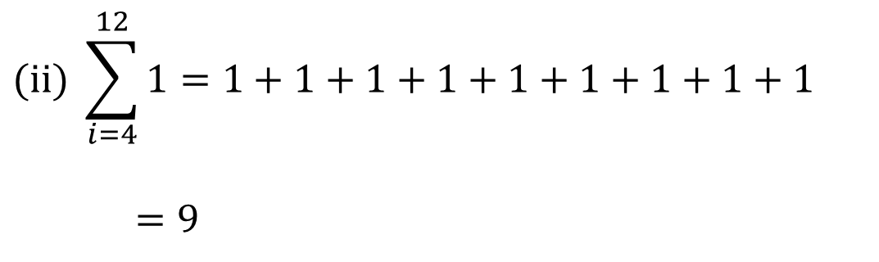
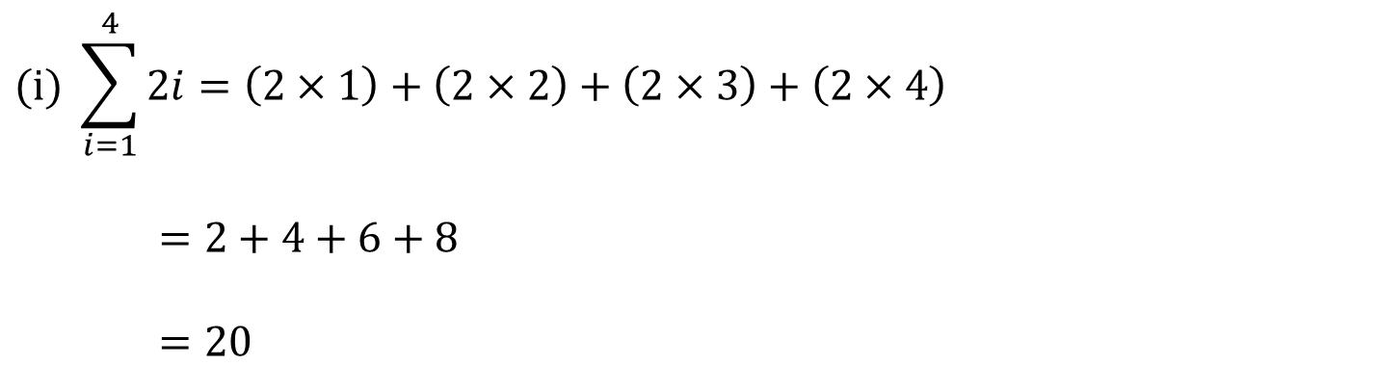
Sigma Notation: Examples
$$(i) \sum_{i=1}^{4}{2i}=\left(2×1\right)+\left(2×2\right)+\left(2×3\right)+\left(2×4\right)$$
$$=2+4+6+8$$
$$=20$$
$$(\text{ii}) \sum_{i=4}^{12}{1}=1+1+1+1+1+1+1+1+1$$
$$=9$$

Slide 27
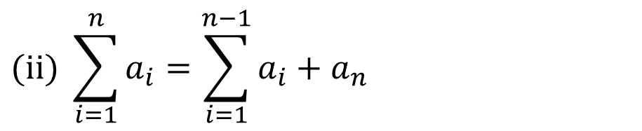
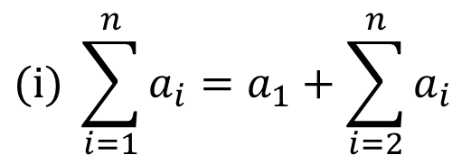
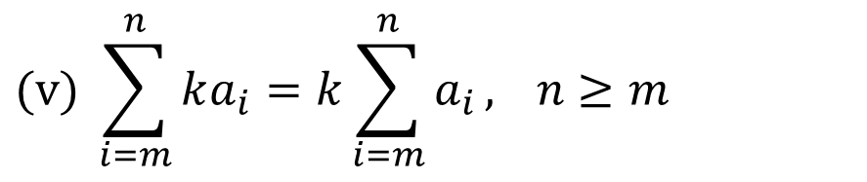
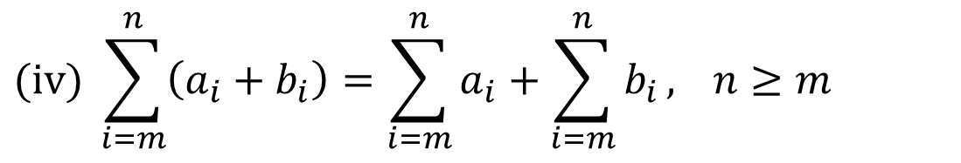
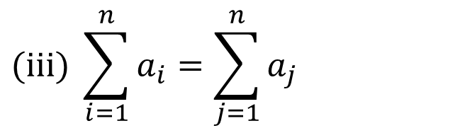
Sigma Notation: Equalities
$$(i) \sum_{i=1}^{n}{a_{i}}=a_{1}+\sum_{i=2}^{n}{a_{i}}$$
$$(\text{ii}) \sum_{i=1}^{n}{a_{i}}=\sum_{i=1}^{n−1}{a_{i}}+a_{n}$$
$$(\text{iii}) \sum_{i=1}^{n}{a_{i}}=\sum_{j=1}^{n}{a_{j}}$$
$$(\text{iv}) \sum_{i=m}^{n}{\left(a_{i}+b_{i}\right)}=\sum_{i=m}^{n}{a_{i}}+\sum_{i=m}^{n}{b_{i}}, n≥m$$
$$(v) \sum_{i=m}^{n}{ka_{i}}=k\sum_{i=m}^{n}{a_{i}}, n≥m$$

Slide 28
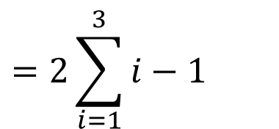

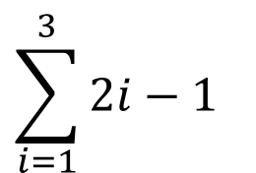
Discussion:
$$\sum_{i=1}^{3}{2i}−1=9$$
True or False?
$$\sum_{i=1}^{3}{2i}−1$$
$$=2\sum_{i=1}^{3}{i}−1$$
= 2(1 + 2 + 3) - 1
= 11 (≠ 9)

Slide 29
Recursive Definitions
Sequences of numbers are defined recursively if each new number depends on previous values.

Slide 30
Recursive Definitions: Example
Let u₁, u₂, …, u_{n}, … be real numbers defined by
u₁ = 2 and u₂= 4
and
u_{n} = 5u_{n - 1} - 6u_{n - 2}, for n ≥ 3.
Find u₄:
u₃ = 5u₂ - 6u₁ (n = 3)
= 5 × 4 – 6 × 2
= 8
u₄ = 5u₃ - 6u₂ (n = 4)
= 5 × 8 – 6 × 4
= 16.

Slide 31
Recursive Definitions: Note
The numbers can often be defined directly.
For example, u_{n} = 2^{n} in the previous example.

Slide 32
The Principle of Strong Mathematical Induction
For integer n, let CLAIM(n) be a statement and let a and b be fixed integers with a ≤ b. If
1. CLAIM(a), …, CLAIM(b) are true, and
2. the truth of CLAIM(i) for all integers i with
a ≤ i < k implies the truth of CLAIM(k) for all integers k > b,
then CLAIM(n) is true for all integers n ≥ a.

Slide 33
Aside: Notes on Divisibility
The expression “a | b” reads “a divides b”, or, “a is a factor of b”, or, “a is a divisor of b”.
It means “b is divisible by a”, or, “b is a multiple of a”, or more formally, there is an l ∈ ℤ so that b = al.
Examples.
(i) 6 | 12
(ii) 7 | (a² – 2) ⇔ there is l ∈ ℤ, a² – 2 = 7l.
(iii) 6 | 25 reads “6 does not divide 25”.
When a proof involves showing a | b, you need to express b as a multiple of a, that is, find l ∈ ℤ so that b = al.
/

Slide 34
The Principle of Strong Mathematical Induction: Example
Suppose that b₁, b₂, b₃, … is a sequence defined as follows:
b₁ = 4, b₂ = 12,
b_{k} = b_{k - 2} + b_{k - 1} for all integers k ≥ 3.
Prove that b_{n} is divisible by 4 for all integers n ≥ 1.
Let CLAIM(n) be b_{n} is divisible by 4.
Step 1: CLAIM(1) is b₁ = 4 is divisible by 4.
CLAIM(2) is b₂ =12 is divisible by 4.
Since 4 and 12 are divisible by 4, CLAIM(1) and CLAIM(2) are true.
Notes:
Given any real number x, the floor of x, or greatest integer in x, denoted ⎣x⎦, is the largest integer that is less than or equal to x.

Slide 35
The Principle of Strong Mathematical Induction: Example
Step 2: Let k > 2 be an integer, and suppose Claim(i) is true for all integers i with 1 ≤ i < k. That is, b_{i} is divisible by 4 for all integers i with 1 ≤ i < k. That is, (*)
Prove that CLAIM(k) is true, that is, prove that b_{k} is divisible by 4.
Now, b_{k} = b_{k - 2} + b_{k - 1}.
Since k > 2, 1 ≤ k – 2 < k and 1 < k – 1 < k , and so, by inductive hypothesis, both b_{k - 2} and b_{k – 1} are divisible by 4.
From definition of divisibility, this implies that b_{k - 2} = 4x and b_{k – 1} = 4y, where x, y ∈ Z.
Thus, b_{k} = b_{k - 2} + b_{k – 1} = 4(x + y), where x + y ∈ Z.
Hence, b_{k} is divisible by 4.
Therefore, CLAIM(k) is true.
Therefore, by induction, CLAIM(n) is true for all integers n ≥ 1.

Slide 36
Appendix: Formula for Algebraic Expansion
(x + y)² = x² + y² + 2xy
(x + y)³ = x³ + y³ + 3xy(x + y)

Slide 37
End of Unit 3

